Slide 1

UK's Road
Accident
Analysis
-DHANANAJY METANGALE

Slide 2


AIM
To Analyze the road accidents in UK
and create a dynamic dashboard

Slide 3

Primary KPIs
Total current year casualties
Total current year accidents
Current year Fatal Casualties
Current year Serious Casualties
Current year Slight Casualties

Slide 4


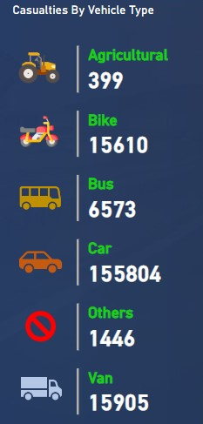


Secondary
KPIs

Slide 5



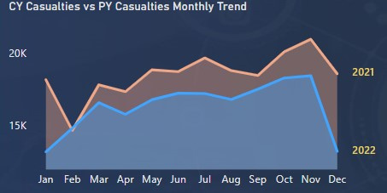

Monthly Trend

Slide 6


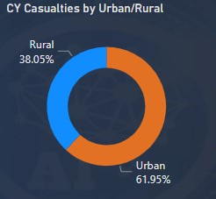
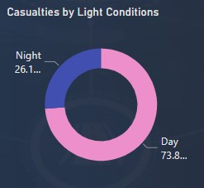
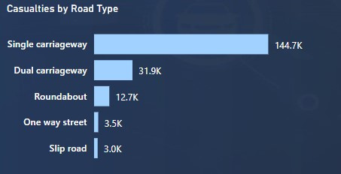
Other Charts

Slide 7
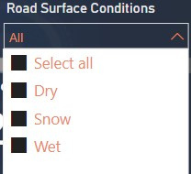
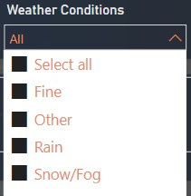


Slicers

Slide 8
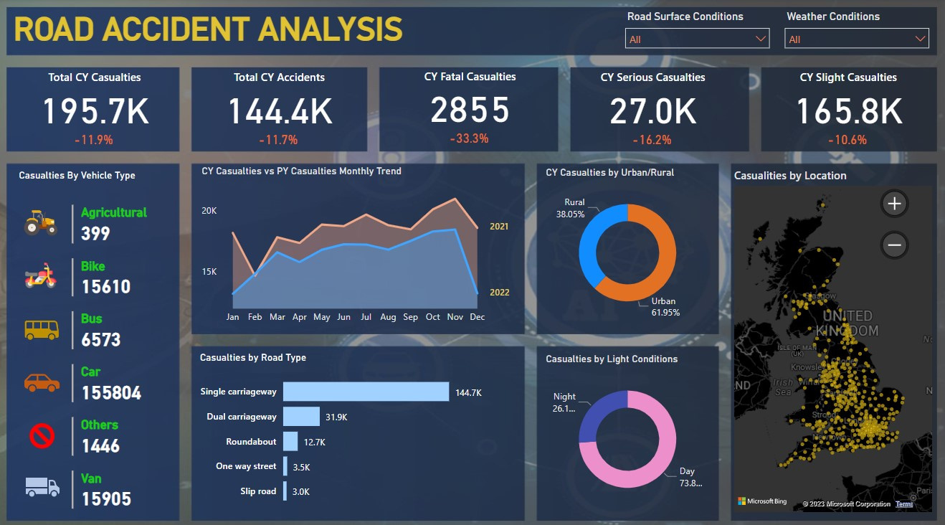

Slide 9


